Slide 1

Team Name : UBXTY- Unboxing Technology
Team Leader Name : Ravdeep Singh
Problem Statement : India is the "Diabetes Capital of the World," and 1 in 5 Indian women suffer from PCOS. Current health apps are reactive (tracking symptoms after they occur) and use linear rules (generic advice for everyone). They fail to account for the fact that metabolic health is non-linear—stress and food affect every individual differently.
Project Name : HormoneLens - See Your Health Before You Live It !

Slide 2

Brief about the Idea: HormoneLens is an AI-powered "Hormonal Digital Twin." Instead of just logging past data, it creates a virtual mirror of the user's metabolism. It allows users to counterfactualize their health that is simulating how a specific meal or missed sleep will impact their glucose and cortisol levels before they make the decision. This shifts healthcare from Reactive Tracking to Predictive Simulation.
Users can input lifestyle patterns and predict risks like:
Simulation Output | For PCOS Users | For Diabetic Users
Insulin Sensitivity | Predict Androgen Imbalance | Predict Glucose Spike
Sleep Cycle Impact | Cycle Delay Risk Forecast | Fasting Sugar Variation
Meal Timing Effect | Ovulation Stability Risk | Post-meal Sugar Level
Stress Level Simulation | Cortisol Imbalance Detection | Insulin Resistance Risk

Slide 3
Predictive Simulation vs Traditional Health Tracking:
How is it Different?
Traditional Health Apps (Rule-Based) | HormoneLens (Predictive System)
Monitor past lifestyle data | Predict future hormonal outcomes
Detect issues after symptoms appear | Identify risks before they occur
Provide general recommendations | Provide personalized predictions
Static health reports | Simulated lifestyle impact analysis
Reactive healthcare approach | Preventive healthcare approach
Same advice for all users | Individual metabolic response model

Slide 4
Predictive Simulation vs Traditional Health Tracking:
How Does It Solve the Problem?
1. Shift from Reactive to Predictive
Current Solution: Traditional apps are "rear-view mirrors"—they only track spikes after they happen. HormoneLens Solution: Acts as a "Flight Simulator" for metabolism. It predicts biological costs (insulin/cortisol spikes) before the user eats or sleeps, preventing damage before it occurs.
2. Solving the "Non-Linear" Complexity The Gap: Rule-based apps use linear logic (e.g., "If Sugar > X, then Bad"). Our AI: Metabolism is non-linear. HormoneLens leverages Amazon Bedrock to perform complex semantic reasoning. It analyzes how Stress, Sleep, and Diet interact uniquely for each user, identifying metabolic risks that static rules completely miss.

Slide 5
Predictive Simulation vs Traditional Health Tracking:
How Does It Solve the Problem?
3. The "Counterfactual" Engine
Capability: Allows users to run "What-If" Scenarios.
Example: "If I eat pizza now vs. tomorrow morning, how does my risk change?"
Outcome: Empowering users to fail in the simulation so they can succeed in reality.
4. Bridging the Specialist Gap
The Reality: India faces a massive shortage of endocrinologists (1 for every ~50,000 diabetic/PCOS patients). The Solution: HormoneAI democratizes specialist-level care. It uses Amazon Bedrock to translate complex medical data into simple, vernacular insights, making precision health accessible to women across Tier-2 and Tier-3 cities.

Slide 6
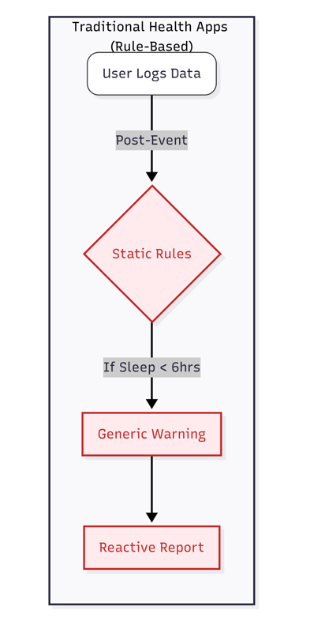
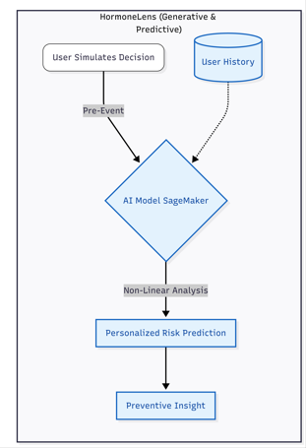
Predictive Simulation vs Traditional Health Tracking:
VS

Slide 7
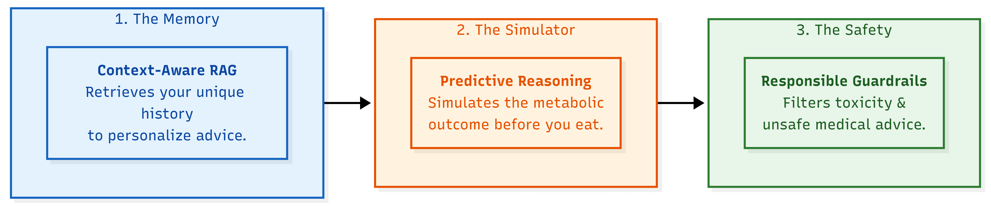
USP of the proposed solution:
From Hindsight to Foresight: The world's first metabolic "Flight Simulator" that predicts glucose spikes before they happen.
Hyper-Personalized RAG: Uses Retrieval Augmented Generation to "remember" your unique biological history, not just general medical data.
Responsible AI Core: Built on AWS Bedrock Guardrails for trusted, safe, and ethical health guidance.

Slide 8
List of features offered by the solution:
Pre-Meal "Flash Forward" Simulation - Allows users to "test drive" a meal before eating it. The AI predicts the metabolic cost (e.g., "High Glucose Spike") based on current stress and sleep levels.
Context-Aware RAG Engine - Unlike generic apps, HormoneLens retrieves your specific historical data (e.g., "You spike on rice, but not on wheat") to personalize every prediction.
Dynamic Metabolic Risk Score - A real-time, multivariate score (Low/Medium/High) that updates instantly as your sleep, stress, or diet inputs change throughout the day.
Explainable AI Insights - Doesn't just say "Don't eat that." It explains why using natural language (e.g., "Avoid pizza tonight because your sleep was poor (5h), reducing your insulin sensitivity").
Clinical Safety Guardrails - Powered by Amazon Bedrock Guardrails to filter out harmful advice and ensure the AI never hallucinates medical prescriptions.

Slide 9
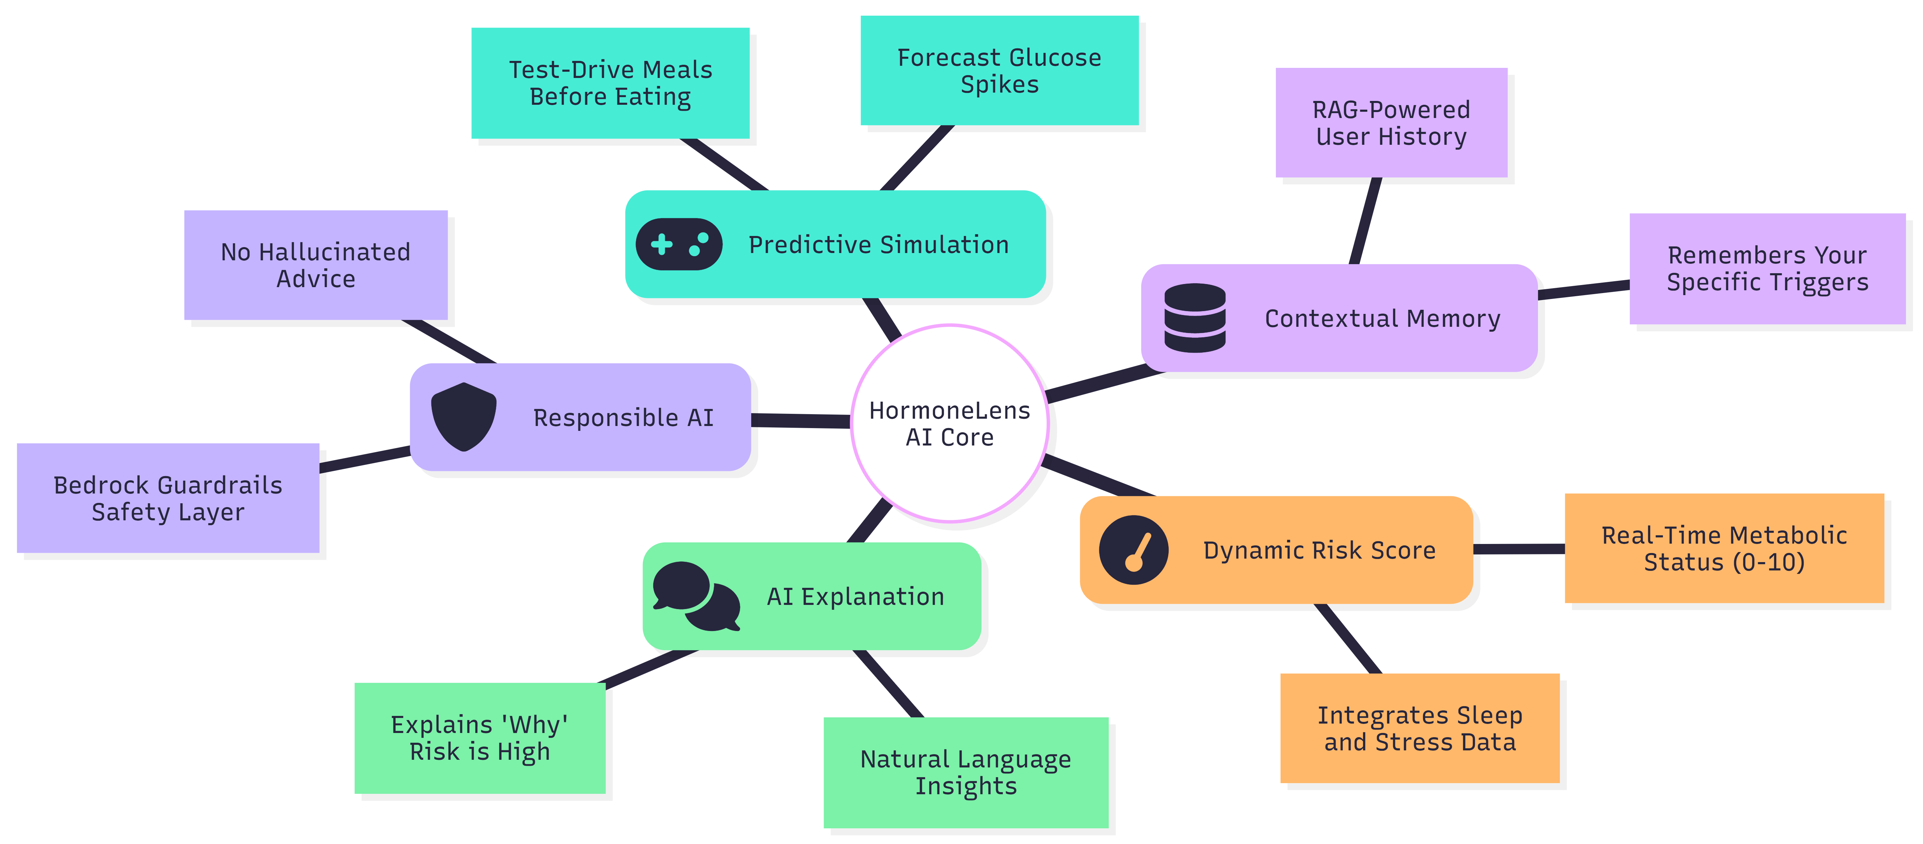
List of features offered by the solution:

Slide 10
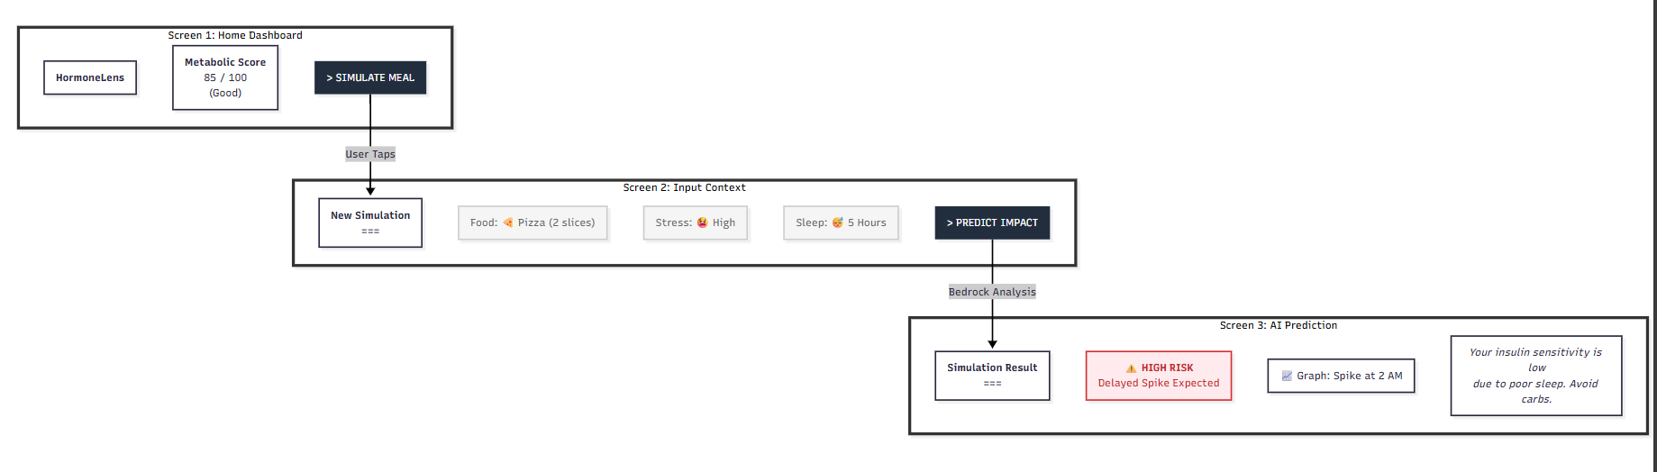
Wireframe diagram of the proposed solution:

Slide 11
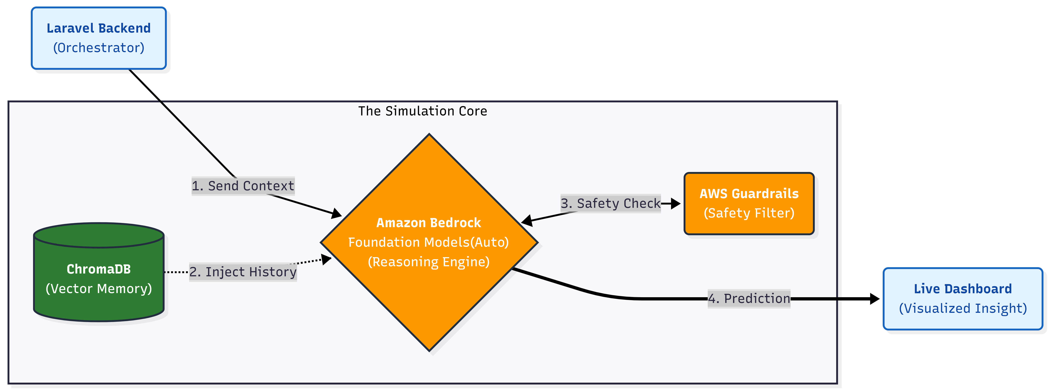
Architecture diagram of the proposed solution:

Slide 12
System Architecture: The Simulation Core
1. The Orchestration Layer
Laravel Backend (The Orchestrator): Manages user authentication, coordinates API requests, and chains prompts to the AI core.
Live Dashboard: Renders real-time metabolic insights and predictive graphs using a seamless frontend-to-backend connection.
2. The Intelligence Core (AWS-Powered)
Reasoning Engine (Amazon Bedrock): Utilizes Bedrock to perform complex semantic reasoning across disparate data points like sleep, stress, and nutrition.
Contextual Memory (ChromaDB): A high-performance Vector Database that retrieves a user’s unique historical health patterns to ground every AI prediction in reality.
Safety Shield (AWS Guardrails): A dedicated layer that filters AI responses in real-time to prevent medical hallucinations and ensure 100% responsible guidance.
3. Data Flow & Precision
RAG-Driven Predictions: Instead of static rules, the system "injects history" into the model, allowing for a hyper-personalized simulation of future metabolic events.
Pre-Meal Foresight: The architecture is designed to handle "What-If" scenarios, processing input context to visualize risks before they occur.

Slide 13
Technologies to be used in the solution:
Component | Technology Used | What it does?
Generative AI | Amazon Bedrock | Reasoning Engine: Simulates metabolic risks.
AI Safety | Amazon Bedrock Guardrails | Safety Layer: Filters unsafe medical advice.
Backend | Laravel (PHP) | Orchestrates app logic & AI prompts.
Database | PostgreSQL | Stores structured user profiles & logs.
Vector Database | ChromaDB | Memory: Retrieves past health context for RAG.
Cache Layer | Redis | Caches frequent simulation requests.
Real-time Engine | Laravel Reverb | Pushes live risk alerts to the dashboard.
RAG Pipeline | Custom RAG | Fetches user's historical patterns.
Data Visualization | Chart.js | Renders predicted glucose spike graphs.

Slide 14
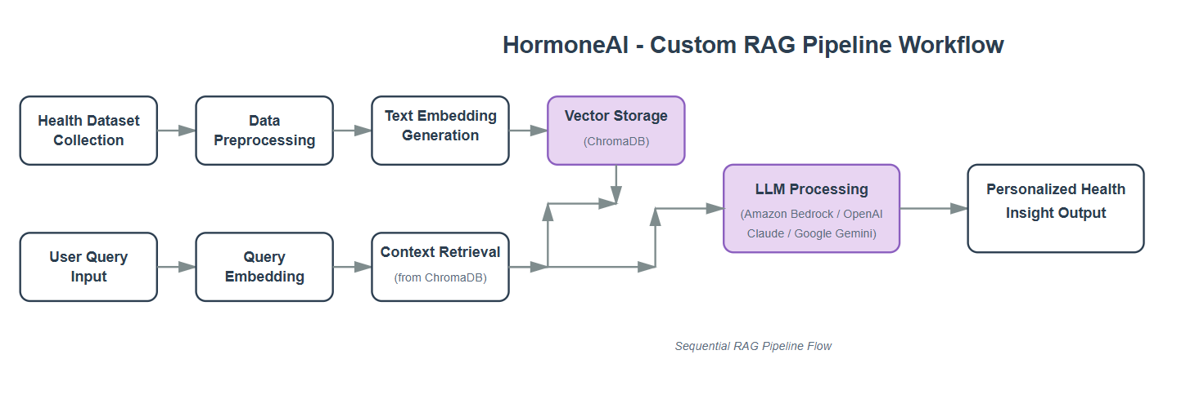
RAG Pipeline Workflow:

Slide 15
LLM Integration:
LLM Feature | AWS Service / Model | Role in HormoneLens
Foundation Engine | Amazon Bedrock | Performs complex metabolic reasoning and "What-If" simulations.
Retrieval (RAG) | Amazon Bedrock Knowledge Bases | Connects the LLM to ChromaDB for hyper-personalized historical context.
Safety & Privacy | Amazon Bedrock Guardrails | Filters responses to ensure responsible, non-diagnostic wellness guidance.
Response Synthesis | Claude 3.5 Sonnet | Translates complex biological risks into natural language "Preventive Insights".

Slide 16
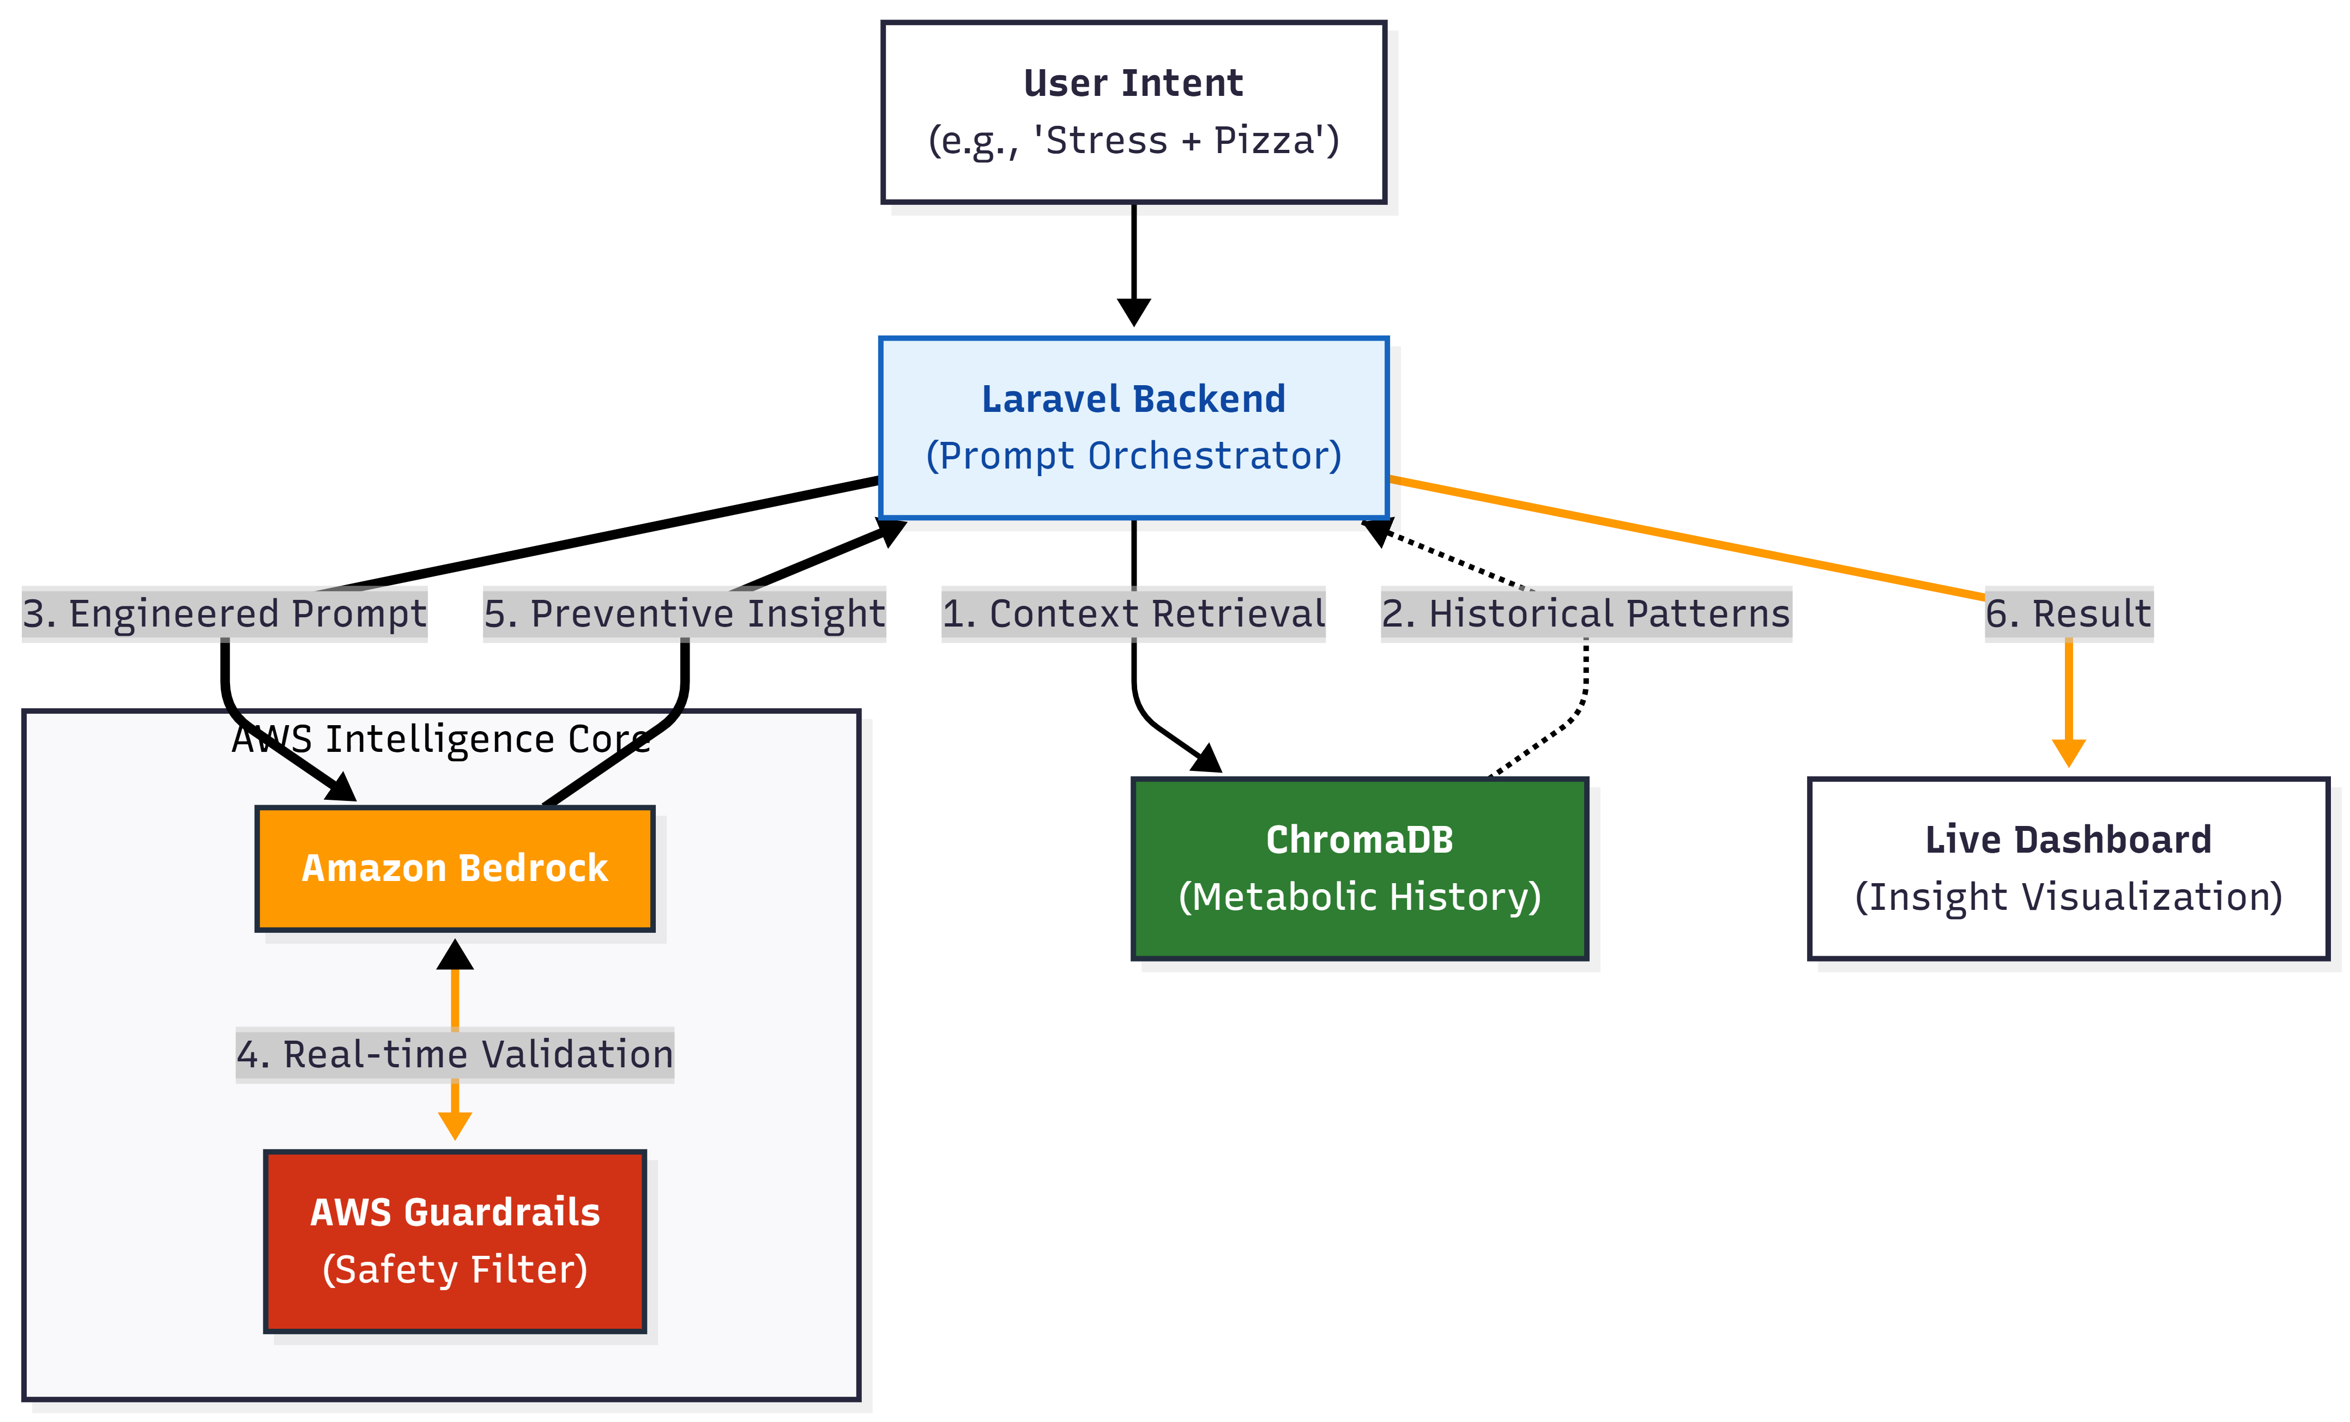
LLM Integration:

Slide 17
Expected Impact:
Shift from Reactive to Proactive - Transforms healthcare from logging sickness (after it happens) to preventing spikes (before they happen), potentially reducing HbA1c levels by 15-20% in early users.
Democratizing Specialized Care - Provides "Endocrinologist-level" logic to millions of Indian women with PCOS who cannot afford frequent doctor visits, directly addressing the AI for Bharat mission.
Behavioral Nudging - Unlike static warnings, our "Simulation" approach empowers users to self-correct lifestyle choices in real-time, improving long-term metabolic literacy.
Safe & Responsible AI - Sets a new standard for health apps by using AWS Guardrails to eliminate medical hallucinations, ensuring trust and safety.
Eliminating "Food Anxiety" - Diagnosed patients often fear every meal. HormoneLens replaces fear with certainty. Instead of worrying "Can I eat this?", the user gets a clear simulation, significantly reducing the mental burden of chronic disease management.

Slide 18
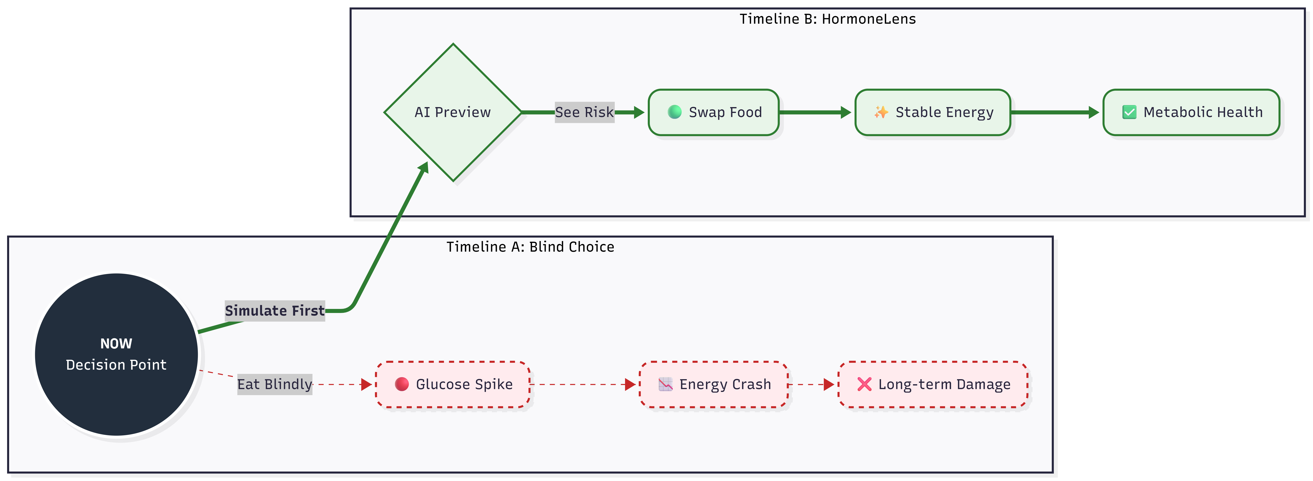
Expected Impact:

Slide 19
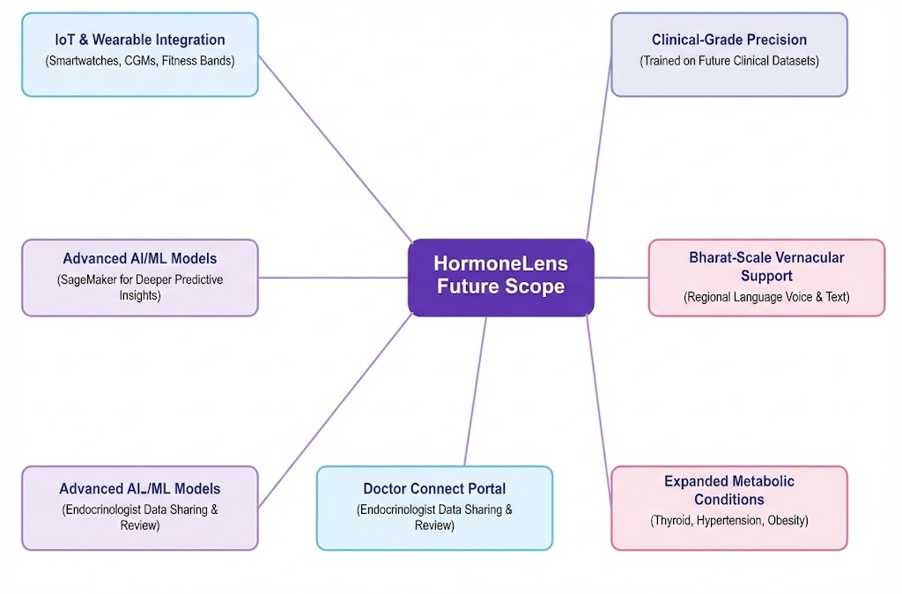
Future Scope:
Integration with wearable health devices
Real-time glucose monitoring support
Mobile application development
Clinical dataset integration
AI-based doctor recommendation system
Expansion to additional metabolic disorders

Slide 20


